Slide 1

Go, change the world
RV College of
Engineering
Monte Carlo Simulation

Slide 2
Monte Carlo simulation
Business Application of
random variables

Slide 3
INDEX
Recap
Monte Carlo Simulation
Introduction
Example
Code
Result
Principle
History
Applications

Slide 4
ReCAP: Random Variables
MONTE CARLO simulation is a model to predict the probability of various outcomes when the potential for random variables is present.
RANDOM VARIABLE is a variable whose value is unknown or a function that assigns values to each of an experiment's outcomes
Random Variable, Y =
Number of heads we get from
tossing two coins
0
1
2

Slide 5
MONTE CARLO Simulation
The Monte Carlo simulation is a mathematical technique that predicts possible outcomes of an uncertain event
It relies on repeated random sampling to obtain numerical results
It can be used analyze past data and predict a range of future outcomes based on a choice of action

Slide 6





Example
Complete 2 reports
It’s 7 am on Friday, and your BOSS assigns you work
You have plans at 6 pm

Slide 7
Monte Carlo Approach
We’ll come up with some measure of uncertainty for each factor
What are the chances you could finish these 2 reports in time (9 hours)
1 – 5 hours
2 - 6 hours
Your performance on ONE report has no influence on the OTHER report

Slide 8
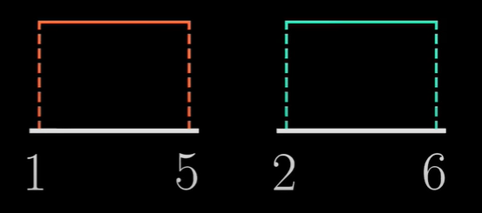
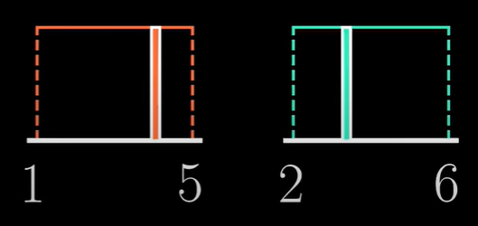
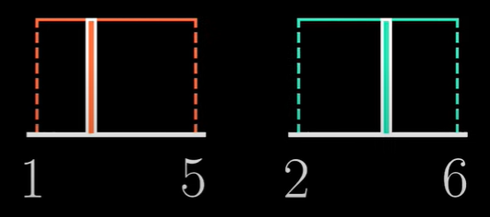
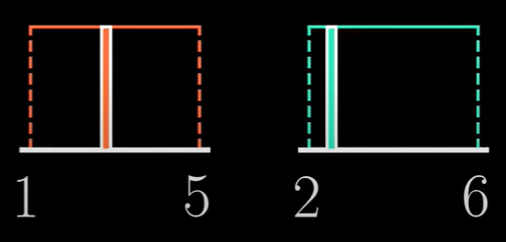
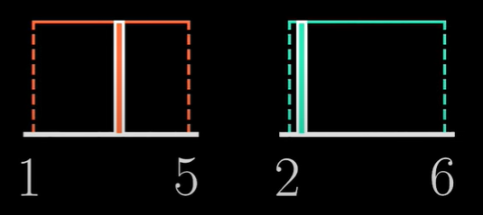
Monte Carlo Simulation
We run a program to randomly pick the time to complete each report
1 – 5 hours
2 - 6 hours
Uniform Distribution
… thousands of times

Slide 9
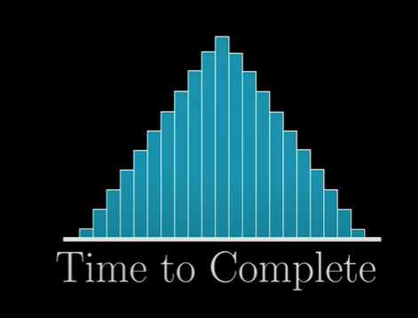
We can use the stored results to approximately estimate the distribution around the time to complete both reports
… thousands of times
We store all the randomly selected values
We can now use this to figure out the chance we’ll complete it by 6 pm

Slide 10
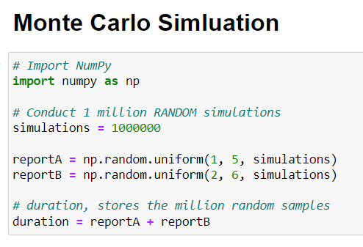
CODE

Slide 11
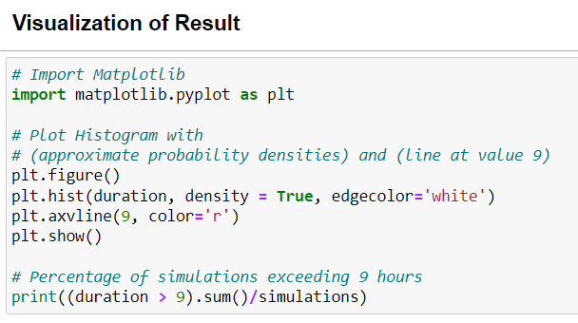
CODE

Slide 12
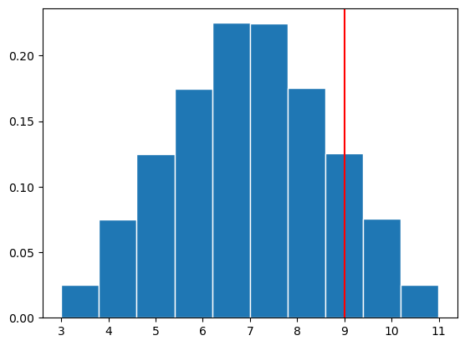


RESULT
There’s 12.54 % chance you will not finish the reports in 9 hours

Slide 13
Monte Carlo - Principle
When faced with significant uncertainty in making a forecast or estimate, some methods replace the uncertain variable with a single average number
The Monte Carlo simulation instead uses multiple values (by repeating random samples) and then averages the results
Principle of Ergodicity, describes the statistical behavior of a moving point in an enclosed system, the point will eventually pass every possible location
This becomes the basis of the Monte Carlo simulation, in which the computer runs enough simulations to produce the eventual outcome of different inputs.

Slide 14
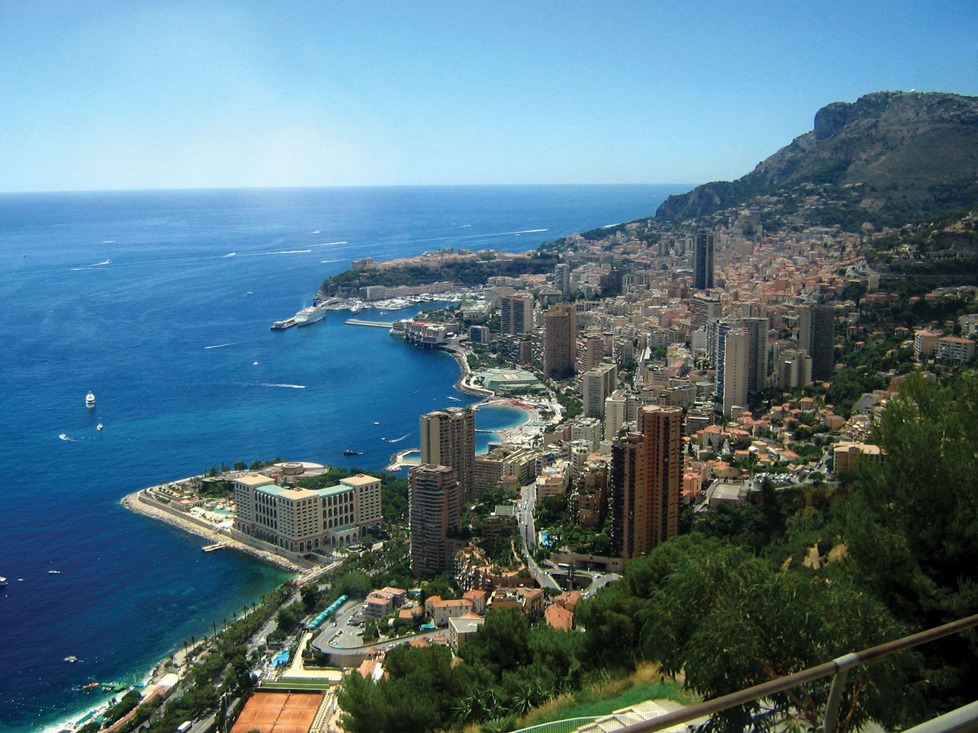
Monte Carlo - History
Enrico Fermi uses Monte Carlo to calculate neutron diffusion
1930
Made significant contributions while working on the Manhattan Project
Stan Ulam
John von Neumann
Monte Carlo is a resort in Monaco known for its Casino, which produces RANDOM results

Slide 15
Monte Carlo - Applications
The Monte Carlo simulation is used to estimate the probability of a certain income. As such, it is widely used by investors and financial analysts
Pricing Stock Options: The potential price movements of the underlying asset are tracked given every possible variable. This is intended to indicate the probable payoff of the options
Portfolio Valuation: Several alternative portfolios can be tested using the Monte Carlo simulation to arrive at a measure of their comparative risk

Slide 16
THANK YOU

